Slide 1

Examiner standardization Cases

Slide 2
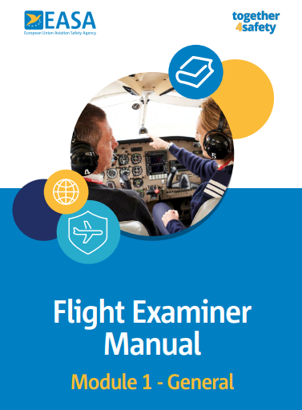
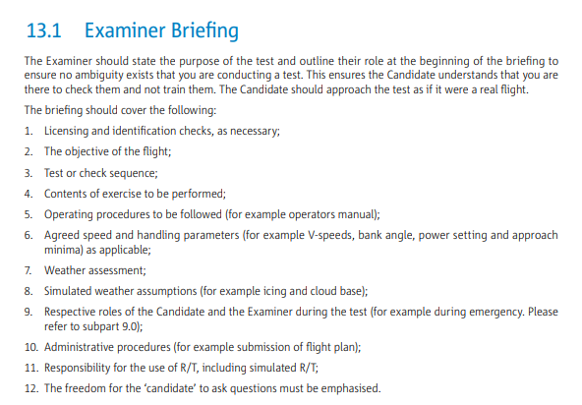
Where can you find information of how to conduct a LPC or a skilltest?

Slide 3
Pass / Fail ?
Part FCL Appendix 9 substantiates flight test tolerances and Pass / Fail criteria.
Governing principles:
If outcome of an exercise during a test or check would endanger or create harm to people on board or on the ground the outcome should be a failure with no retake.
(e.g., Aircraft crash, vacating runway, imminent impact with ground etc.)
A general guiding principle is using the analogy: “If the test or check was performed in a real aircraft, would you allow a retake ?“
The outcome of a test or check item should not be based on luck - but competence(s)demonstrated by the pilot(s) and assessed by the examiner.

Slide 4
May you as examiner check any items on an LPC?
May you request a pilot on a regular PC, to perform following exercise as a check:
A raw data ILS with FD & AP off
Having in mind that this is only a requirement for a skilltest?
Yes!
As examiner you may request to see any items or maneuver!
Just remember – a raw data is normally only a requirement during a skilltest

Slide 5
Item 3.9.4 2D operations down to MDH/A
May you request a pilot on a regular PC, to perform following exercise as a check:
Single engine 2D approach?
Yes – just as before!
Item 3.9.4 2D operations down to MDH/A does not dictate single engine operation – but again – it is the choice of the examiner!

Slide 6
Validity period
An applicant has not been flying the aircraft during the last validity period, as he does not hold a pilot job.
Any considerations when performing a revalidation PC?
1 route sector must be performed with an Examiner

Slide 7
No PBN privileges
The aircraft or simulator you shall perform a LPC on is not approved for PBN.
May you perform the LPC?
…and if yes:
What is your action?
Yes – you may perform the PC.
However:
PBN privileges of the pilot shall not include RNP APCH
So, write a comment in the remark field – and do NOT endorse the license!
Trafikstyrelsen will ensure correct license

Slide 8
Assist pilot
During an LPC for a foreign company, one of the pilots has called in sick and a French licensed assist is called in.
The performance of the assist is extremely poor, and safety is often jeopardized.
How do you handle this situation?
You have no authority over this pilot, so your only option is to contact the French authorities.

Slide 9
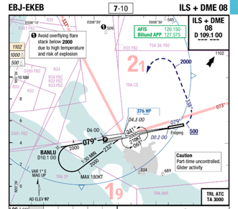
Which Airspace?
During a diversion to EKEB the pilots decides to enter HP holding.
A helicopter is already in the HP holding at 2500’ and the pilots of the aircraft joins the holding at 3000’
What will you grade?

Slide 10
Which Airspace?
The airspace in “G” – so own separation must be maintained – and in fact, this is the case here!!
However – a discussion during debriefing could be airmanship. E.g., wake turbulence?

Slide 11
Expired rating
A pilot is expired on his A320 rating for 9 years.
No privileges have been held since.
What is required to be current and able to fly the A320 again?
Theory
Medical
Radio License
Renewal Training (ATO)
LPC

Slide 12
Expired medical
One of the pilots shows up to his LPC with an expired medical
What do you do?
That is no problem – perhaps a company requirement, but not for the CAA.
However - The pilot must not exercise the privileges of the License until he has a valid medical.

Slide 13
SFI assist
One of the pilots does not show up to his LPC.
An SFI working in the training center offers to fly as assist.
What do you do?
Is the SFI qualified (Valid LPC) – then it is ok
But do observe that not all SFI’s hold a valid LPC!

Slide 14
The pilot stops the test
A pilot is performing well, but when 4 exercises remains, he says he feels sick and wants to stop the test.
What do you do?
You have 2 options:
Incomplete or FAIL, depending on whether your judgement: is an acceptable reason or not ?

Slide 15
Turn left right here
You are performing a License Proficiency Check with your employer and your fellow instructor.
During taxi you give them the ATC clearance: “After departure runway 08, turn left heading 260 degrees and climb 9000ft”.
Correct read back is received from the crew.
After departure the crew turns right heading 260 degrees and climbs to 9000ft.
The point is in fact not the wrong turn – but the fact that YOU are performing a test with your employer!!
Is vested interest a subject – YES – don’t do that
And ps: It is a full fail if the crew does not follow ATC instructions (item 3.9.1)

Slide 16
Houston – we have a problem
A crew is flying inbound TARUS VOR at FL390 and receive the clearance:
“Descend FL190 and be level FL190 when passing TARUS”.
The crew starts descend too late and even with the use of speed brakes, they are unable to reach FL190 at TARUS.
They pass TARUS at FL198.
The crew does not inform ATC that they are 800’ high when passing TARUS.
Item 3.9.1.is failed!
(Follow ATC instructions)
And so is the entire test
The outcome of an exercise may not be caused by luck
Retake of the item is not an option

Slide 17
Overspeed
A pilot is performing a go around after an ILS approach and during this manoeuvre, the pitch up rate is too slow, causing a flaps overspeed by a 2-3 knots for a few seconds.
What is your action?
Flying outside airplanes limitation – failed item.
Retake is possible

Slide 18
Minima
During a 2D (VOR approach) the pilot decides to execute a missed approach at MDA due to “no visual contact”.
The aircraft sinks 50’ below MDA before positive climb is established.
Flying below minima = the entire test failed.
No retake possible

Slide 19
Joining holding
A crew is flying inbound TARUS to enter TARUS holding.
The crew performs a direct entry in the holding = Wrong Entry
What is your action?
Item 3.9.2. is failed (holding procedure)
Retake is possible

Slide 20
Squawk
During a test, the crew forgets to set the acknowledged transponder code.
What do you do?
Item 3.9.1 (ATC instruction) – however - just ask the crew to recycle the transponder

Slide 21
Smoke indication
A crew has a smoke indication in the cargo compartment and decides to fly below DH to complete the landing, even though visual contact is not established when passing DH.
What is your action?
Ask during the debriefing:
Was this action briefed in advance? Then it is ok.
NORMALLY – only fly below minima for uncontrolled smoke or fire – or low on fuel.
But if crew decides to land due an indication only, it is ok if planned on.

Slide 22
Popped CB
During cockpit inspection the crew does not notice that 3 circuit breakers are popped.
One of these circuit breakers is for the APU which is required to start this aircraft.
When the crew notice that they cannot start the APU, they release the aircraft with the MEL and asks for ground air to start the engines.
The entire test is failed – item 1.3 Cockpit inspection.
No retake is possible

Slide 23
Go-Around!
In a multi crew cockpit, the pilots are flying an ILS approach (MSA is 2000ft). CM1 is PF. When passing 1200ft AGL the aircraft gets ¾ scale left of the localizer.
CM2 calls for a go around. CM1 decides to make a fast correction to become established.
CM2 takes controls and performs a go around.
What is your action?
CM 1 – The entire test is failed
CM 2 – OK – fine and correct action

Slide 24
Wrong checklist
During a check the crew experience a hydraulic failure.
In their effort to solve this problem they read a wrong checklist.
Before this abnormal checklist is completed, they realize that they are reading a wrong checklist.
They undo all the items they did on the wrong checklist and complete the correct checklist.
What is your action?
Fine/OK – if safety not compromised by irreversible items.

Slide 25
High - again
During the final part of a CAT 1 ILS 900ft AGL, still IMC, PF is almost full-scale high on the glideslope.
PM calls for a go around, but PF decides that there is enough runway to complete the landing.
Full failed test for BOTH pilots – and no retake!
PF for not going around
PM for not taking controls

Slide 26
High – again and again
During a LPC on a B200, the pilots sets a wrong HIGH minima (plus 100 feet), resulting in a GA.
What is your action?
Which competency can have influence?
Failed item – but repeat is possible.
This repeat could even be to another RWY, so the pilot have a new chance of reading the plate correctly
WLM may be a factor here

Slide 27
HOT or NOT?
During ground operations in moderate snow the crew does not estimate their hold over time for the deicing fluid used.
When they go airborne there is still 2 minutes before the hold over time expires.
During debriefing – ask into the calculation. If they have a valid explanation that is ok – fine
If not – it is a full failed test!
The outcome of an exercise must not be subject to luck

Slide 28
Use of radar
The crew is informed of CB activity in the vicinity of their destination airport.
Even though they are IMC they do not turn on their weather radar.
Full failed test for both pilots – and no retake is possible

Slide 29
This is your captain speaking
During a test in multi pilot cockpit, the captain, whose performance have been slightly below standard, asks the copilot to prepare the approach (all approaches) including FMS setup etc.
You must make sure the CDR can perform FMS programming!
Incapacitate the copilot, and ask for a new and not programmed approach

Slide 30
Hitman
During a test the Cdr. gets so annoyed with his copilot that he hits him.
What is your action?
CDR is Failed.
(Remember give thorough explanation on respective form)
Remember soft rules form e.g., Appendix 9 “Exercise good judgement and airmanship”, “communicate effectively with fellow crewmembers”

Slide 31
Can you sign here, please?
After completing a PC on an A320/IR the pilot asks if you a cross credit the IR part towards his IR(A)/MEP.
What criteria must be met for this to be possible ?
Check logbook for 3 IFR approaches IR(A)MEP setion 6 completed
Ref: FCL appendix 8 or Examiner.dk

Slide 32
Look out for space shuttles
The crew is cleared to FL 110 – but passing TA they forgets to set 1013 – and are leveling off at 11.000 feet instead.
What is your action?
Full failed session – no retake is possible

Slide 33
Evacuate - Evacuate
After a rejected Takeoff due ongoing fire – the Commander starts the evacuation with both engines running
What is your action versus the CDR?
What is your action versus the FO?
Full failed session for the CDR – no retake is possible.
IF the FO had NO Chance to intervene – the FO shall not be judged on the CDR´s action
IF the FO had able time to intervene – FULL fail with no retake possible.

Slide 34
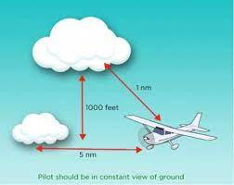
VFR Cases

Slide 35
What distance?
During a CPL Skilltest the pilot in a Piper Arrow is too close to the Sky according to your judgement.
When you challenge the pilot about it – he is stating the correct distance – and that his opinion is the distance was ok.
What do you do?
Remember the Big picture
Is the rest of the test fine - let it pass

Slide 36
What distance again?
During a PPL Skilltest the pilot is approaching EKBI CTR – an no entry clearence is obtained.
What do you do?
Let the pilot fly UP TO the boarder of the CTR (do not enter)
Then takeover and it’s a full failure

Slide 37
Flapless landing
A pilot is asked to perform a flapless landing, but he does not correct his approach speed or his Vth for this flapless approach.
Landing performed with no other comments.
Full Fail – no retake possible
Remember to be clear as examiner on request to the applicant.

Slide 38
Pulled CB
Once airborne on a PC, stall warning starts to sound. continuously. The pilot explains that this has happened before, and he pulls the Circuit Breaker for the stall warning and continue the navigation flight.
He informs you that the test can continue because it is easy to feel the stall buffet in this airplane.
Full Fail – no retake possible

Slide 39
Bank Angle
During a steep turn with 45 degrees bank the pilot is busy looking for other traffic which makes him end up in 75 degrees bank and an altitude loss of 600’ before he recovers.
Full Fail – no retake possible

Slide 40
Slow Flying
A pilot forgets to retract take off flaps.
He does not notice this until his first waypoint 21 minutes out where he arrives 7 minutes late.
This delay makes him trouble shoot and he discover this issue.
A partial pass, if well-handled after discovery, otherwise fail

Slide 41
Nose down or not?
During a clean stall fully developed, the pilot apply full power to recover, but does not lower the aircraft nose.
Recovery was without further remarks.
Failed Item – retake possible

Slide 42
Chocks
During pre-flight inspection, the pilot forgets to remove chocks from his main gear.
After the engine is started and he has tried to taxi by adding a lot of power, he shuts down the engine and walk outside and discovers the problem.
Full Fail – no retake possible

